Slide 1
Building Unit Tests
[Python Restful APIs]
(Without Mocking)

Slide 2
Assumption: Understand basics of Restful APIs, Python development, database development
Libraries used in this presentation:unittest,
json,
requests,
sqlalchemy,
flask,
flask_restful
What you will learn if you don’t already know it:
how to write a first draft of a TDD example for Restful APIs starting at about 1am during a thunderstorm after your truly antique laptop took forever to download Anaconda, then refused multiple times to complete the PyTorch download, preventing you from hastily writing a GANS [Generative adversarial network] example.

Slide 3

I WILL SHARE THE SLIDE DECK VIA THE MEETUP AFTER TONIGHT’S PRESENTATION

Slide 4
High Level Steps for this TDD exercise
Agree on the database structure.
Create database [TDD steps not included here].
Agree on the list of Restful API calls.
Agree on format of return values from each Resful API call.
Create a skeleton server with “pass” for each Resful API resource.
Create a skeleton client which will house request return values for calling the Restful APIs.
Introduce one request at a time, allowing it to fail, then edit the server to deliver the correct return value.

Slide 5
Database steps
Agree on the database structure.
Create database [TDD steps not included here].
Agree on the list of Restful API calls.
Agree on format of return values from each Resful API call.
Create a skeleton server with “pass” for each Resful API resource.
Create a skeleton client which will house request return values for calling the Restful APIs.
Introduce one request at a time, allowing it to fail, then edit the server to deliver the correct return value.

Slide 6
Grades.db database was created with sqlite
students
student_id int primary key,
student_lname varchar2(1000),
student_fname varchar2(1000),
createdby int,
creationdate date
courses
course_id int primary key,
course_name varchar2(1000),
prereq_id int,
createdby int,
creationdate date
grades
grade_id int primary key
student_id int
course_id int
numeric_grade int
createdby int
creationdate date

Slide 7
Restful API agreements
Agree on the database structure.
Create database [TDD steps not included here].
Agree on the list of Restful API calls.
Agree on format of return values from each Resful API call.
Create a skeleton server with “pass” for each Resful API resource.
Create a skeleton client which will house request return values for calling the Restful APIs.
Introduce one request at a time, allowing it to fail, then edit the server to deliver the correct return value.

Slide 8
Courses Restful API
course_id int primary key,
course_name varchar2(1000),
prereq_id int,
createdby int,
creationdate date
Courses
Courses: get: /Courses/<course_id>
{'course': [course_id, course_name, prereq_id, created_by, creation_date]]}
Courses: delete: /Courses/<course_id>
{"deleted_course": course_id})
Courses: put: /Courses/course_name/<course_name>/prereq_id/<prereq_id>/
{expected_id: course_name+" "+prereq_id)}

Slide 9
Students Restful API
student_id int primary key,
student_lname varchar2(1000),
student_fname varchar2(1000),
createdby int,
creationdate date
Students
Students: get: /Students/<student_id>
{'student': [[student_id, lname, fname, created_by, creation_date]]}
Students: delete: /Students/<student_id>
{"deleted_student": expected_id}
Students: put: /Students/StudentLname/<student_lname>/StudentFname/<student_fname>
{student_id: fname+" "+lname}

Slide 10
Grades Restful API
grade_id int primary key
student_id int
course_id int
numeric_grade int
createdby int
creationdate date
Grades
Grades: get: /Grades/<grade_id>
{'grade': [grade_id, student_id, course_id, numeric_grade, created_by, creation_date]]}
Grades: delete: /Grades/<grade_id>
{"deleted_grade": grade_id}
Grades: put: /Grades/student_id/<student_id>/course_id/<course_id>/numeric_grade/<numeric_grade>
{grade_id: student_id+" "+course_id+" "+numeric_grade}

Slide 11
Skeleton server
Agree on the database structure.
Create database [TDD steps not included here].
Agree on the list of Restful API calls.
Agree on format of return values from each Resful API call.
Create a skeleton server with “pass” for each Resful API resource.
Create a skeleton client which will house request return values for calling the Restful APIs.
Introduce one request at a time, allowing it to fail, then edit the server to deliver the correct return value.

Slide 12
Skeleton Students Server Excerpt
class Students(Resource):
def get(self, student_id):
pass
def delete(self,student_id):
pass
class AddStudent(Resource):
def put(self, student_fname, student_lname):
pass
api.add_resource(Students, '/Students/<student_id>')
api.add_resource(AddStudent, '/Students/Student_Fname/<student_fname>/Student_Lname/<student_lname>')

Slide 13
Skeleton Courses Server Excerpt
class Courses(Resource): def get(self, course_id): pass def delete(self,course_id): pass class AddCourse(Resource): def put(self,course_name, prereq_id): pass
api.add_resource(Courses, '/Courses/<course_id>') api.add_resource(AddCourse, '/Courses/course_name/<course_name>/prereq_id/<prereq_id>/')

Slide 14
Skeleton Grades Server Excerpt
class Grades(Resource): def get(self, grade_id): pass def delete(self,grade_id): pass class AddGrade(Resource): def put(self,student_id, course_id, numeric_grade): pass
api.add_resource(Grades, '/Grades/<grade_id>') api.add_resource(AddGrade, '/Grades/student_id/<student_id>/course_id/<course_id>/numeric_grade/<numeric_grade>')

Slide 15
Skeleton client
Agree on the database structure.
Create database [TDD steps not included here].
Agree on the list of Restful API calls.
Agree on format of return values from each Resful API call.
Create a skeleton server with “pass” for each Resful API resource.
Create a skeleton client which will house request return values for calling the Restful APIs.
Introduce one request at a time, allowing it to fail, then edit the server to deliver the correct return value.

Slide 16
class GradesTestCases(unittest.TestCase):
def test_PutGetAndDeleteStudent(self):
self.assertEqual(True,False)
def test_PutGetAndDeleteCourse(self):
self.assertEqual(True,False)
def test_PutGetAndDeleteGrade(self):
self.assertEqual(True,False)

Slide 17
TDD with one case at a time
Agree on the database structure.
Create database [TDD steps not included here].
Agree on the list of Restful API calls.
Agree on format of return values from each Resful API call.
Create a skeleton server with “pass” for each Resful API resource.
Create a skeleton client which will house request return values for calling the Restful APIs.
Introduce one request at a time, allowing it to fail, then edit the server to deliver the correct return value using the red, green, refactor pattern.

Slide 18
Grades example: after introducing 3 asserts
class GradesTestCases(unittest.TestCase):
def test_PutGetAndDeleteStudent(self):
lname = 'Pohl'
fname = 'Erik'
expected_id = '1'
created_by = 1
creation_date = 1
api_url = url_students+'/StudentLname/'+lname+'/StudentFname/'+fname
r_put = requests.put(url=api_url)
print(r_put.status_code, r_put.reason, r_put.text)
api_url = url_students+'/'+expected_id
r_get = requests.get(url=api_url)
print(r_get.status_code, r_get.reason, r_get.text)
print(r_get.text)
api_url = url_students+'/'+expected_id
r_delete = requests.delete(api_url)
self.assertEqual(r_get.text,json.dumps({'student': [[int(expected_id), lname, fname, created_by, creation_date]]})+'\n')
self.assertEqual(r_put.text,json.dumps({expected_id: fname+" "+lname})+'\n')
self.assertEqual(r_delete.text, json.dumps({"deleted_student": expected_id})+'\n')

Slide 19
Thank you to the Boston Software Crafters meetup team for allowing me to present and for creating a space welcoming to collaboration!

Slide 20
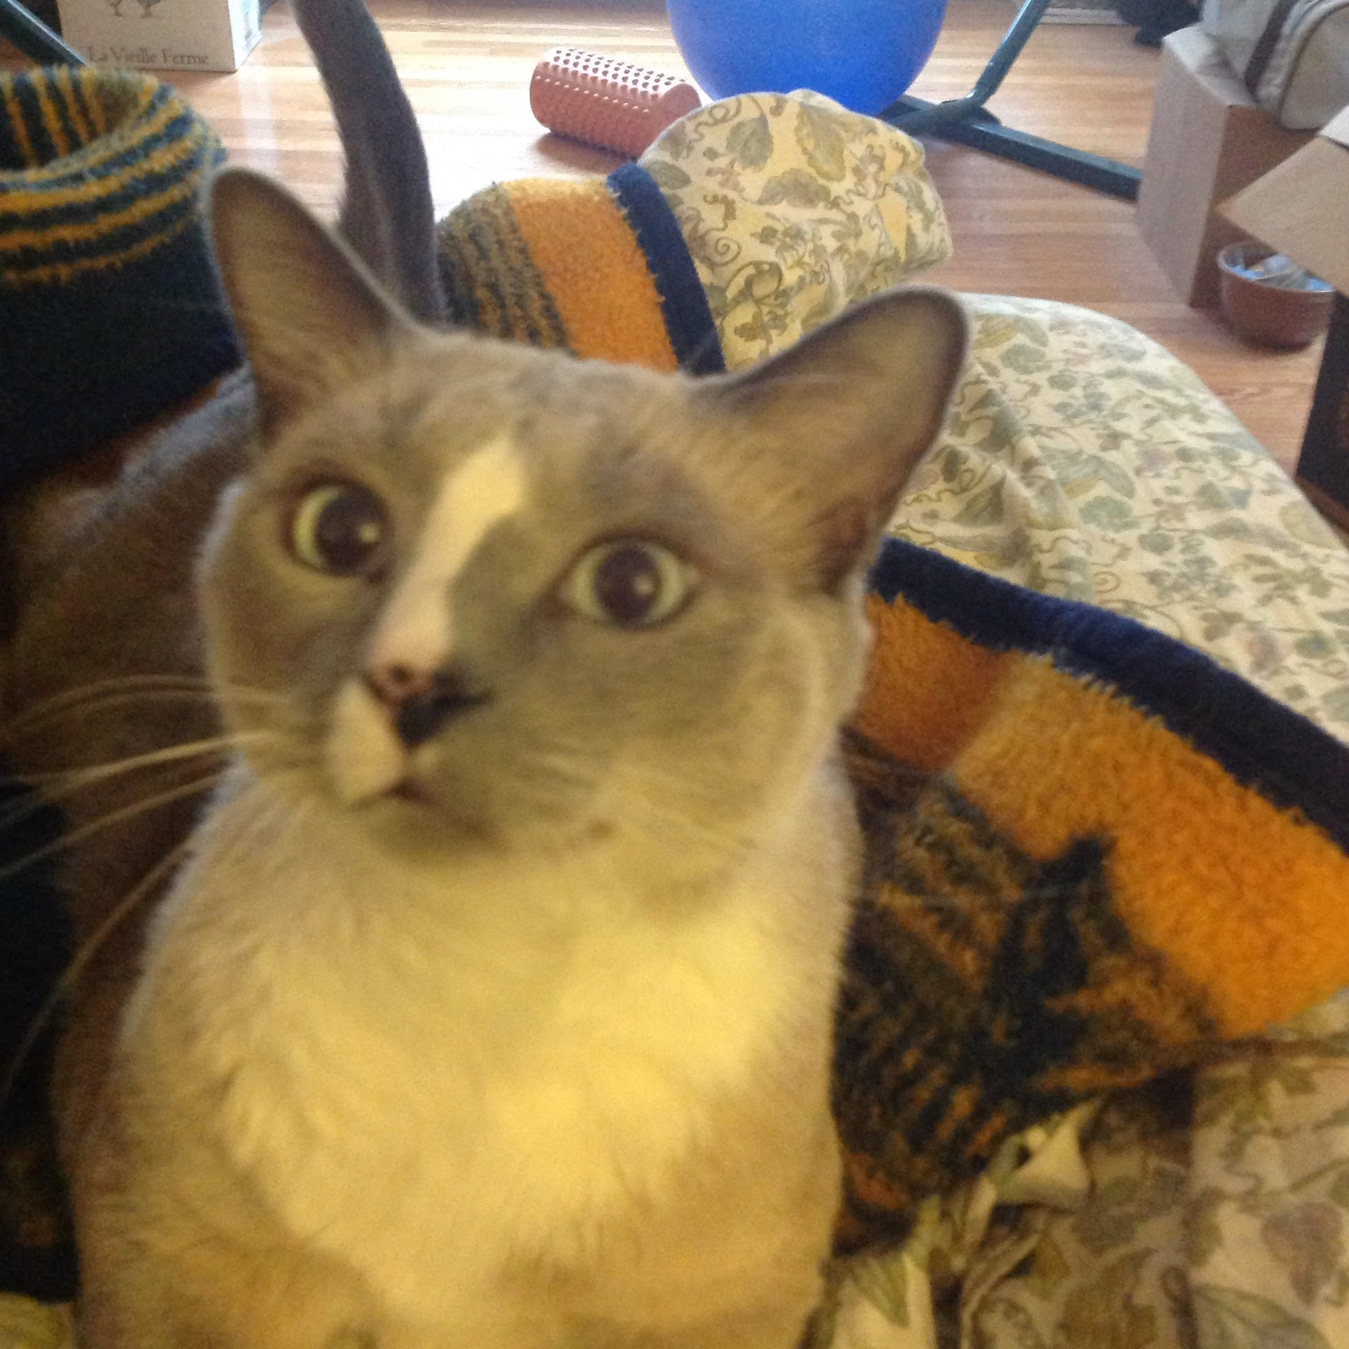
Erik Pohl
erik_pohl@hotmail.com
iotasubscript@gmail.com
Linked In: https://www.linkedin.com/in/erik-pohl-0792159/
GitHub: https://github.com/ErikPohl-Lot49-Projects/Erik-Pohl-Repo/tree/master/python/Grades
My cat, Fritz, who helped a little with this slide deck.

